Slide 1

Analyzing the Adult Dataset
Teammate Names: Matthew Long, Bin Gui, Lance
7-15-2022

Slide 2

Roadmap | Executive Diagram
Teammate Names: Matthew Long, Bin Gui, Lance
Data Processing
Model
Evaluation
Test
First we obtained the dataset from the UCI Machine Learning Repository. We then uploaded this set into a dataframe. The 50k category was one-hot encoded so that it could store numerical values. Finally, we separated the dataset into a training and testing set.
We implemented both a decision tree model and a logistic regression neural network for this data set since it was a classification problem.
For our evaluation, we used the metrics of entropy and accuracy. To streamline our results, we will focus on accuracy as the basis of our evaluation.
After creating, training, and testing the models, the target value was classified at 79% accuracy with the decision tree and logistic regression performing at the same levels.

Slide 3

Dataset Overview
Teammate Names: Matthew Long, Bin Gui, Lance
The dataset 48842 instances and 14 attributes relating to an adults.
Attributes include age, education, occupation, education number, race, etc.
Our target attribute is whether the income is over or under $50k.
We will be testing different features to reach an accurate prediction.

Slide 4

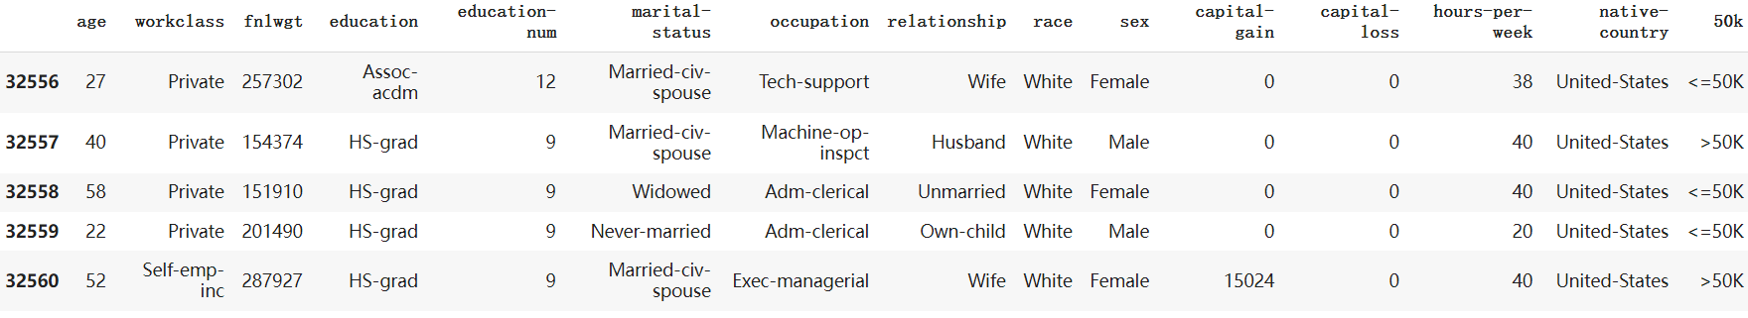
Data Display
Teammate Names: Matthew Long, Bin Gui, Lance

Slide 5
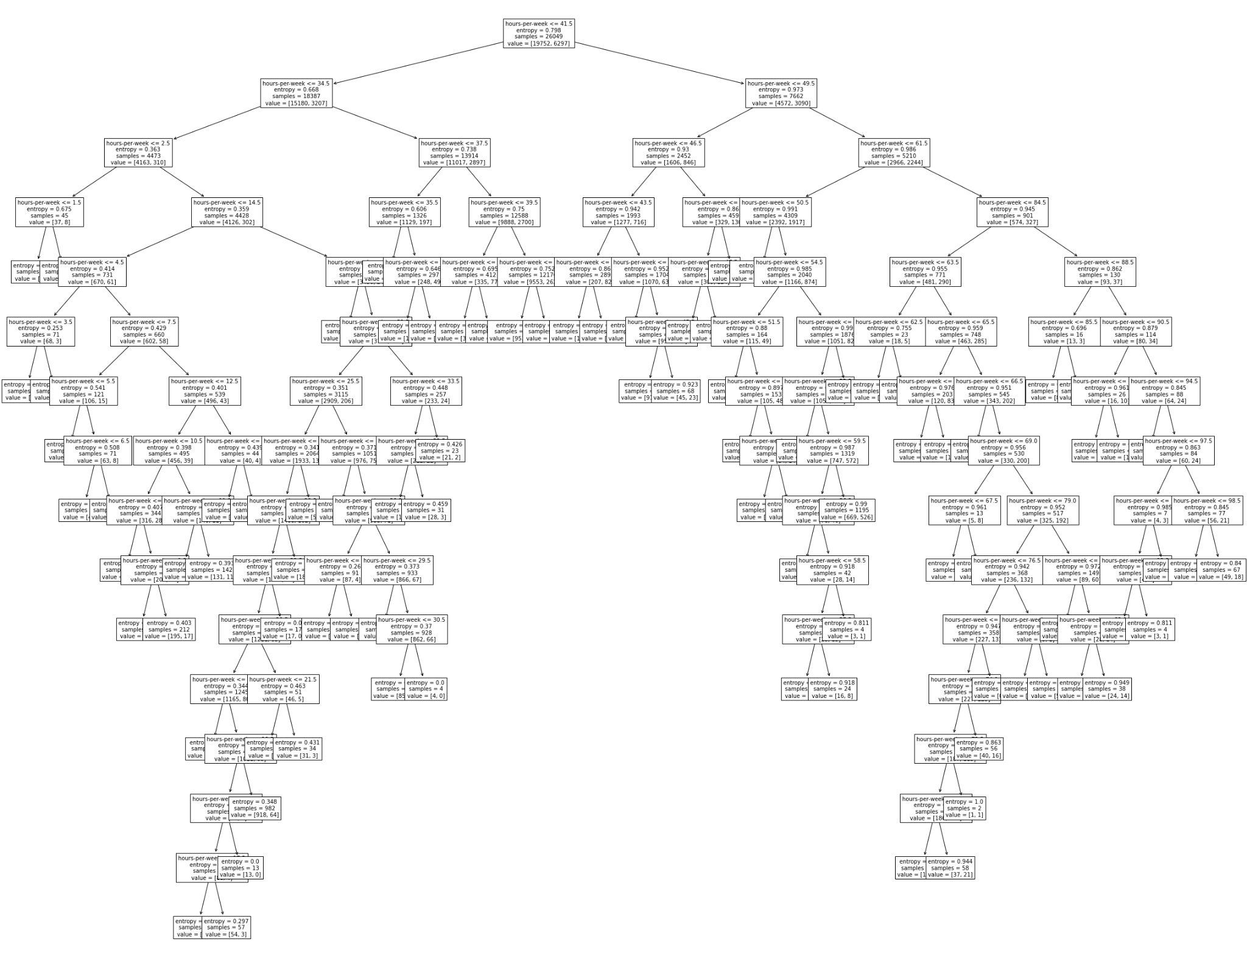
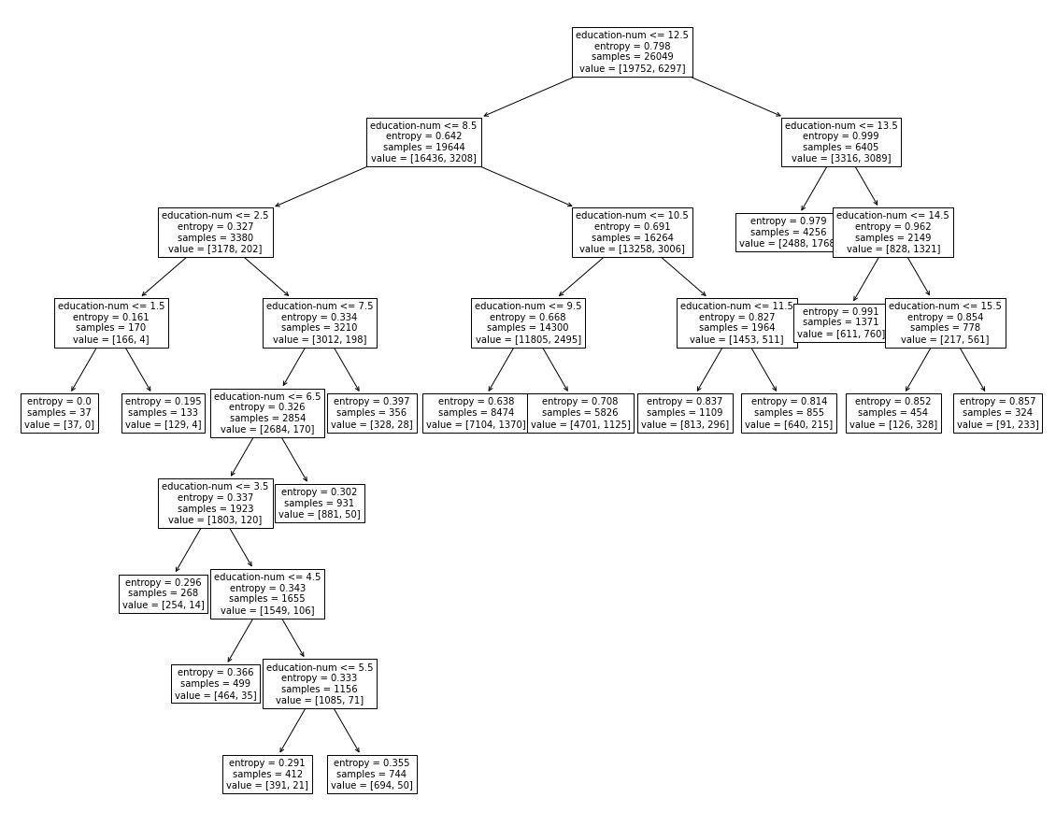
Model Construction
Teammate Names: Matthew Long, Bin Gui, Lance
Our first model was a decision tree. We tried to implement different features, but we found that education-num provided the highest accuracy. Other features, such as age and work hours, created much more expansive trees with lower accuracies.
Fig 1: Decision tree for work hours/week
Fig 2: Final Decision tree for education num

Slide 6
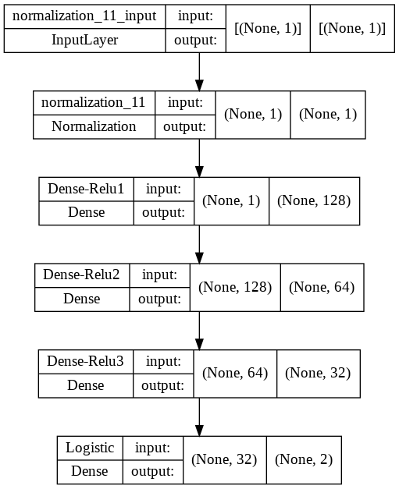
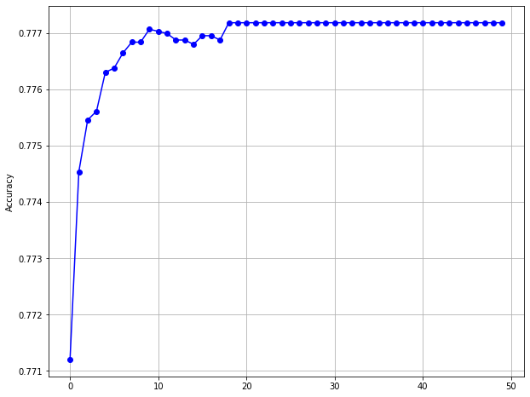
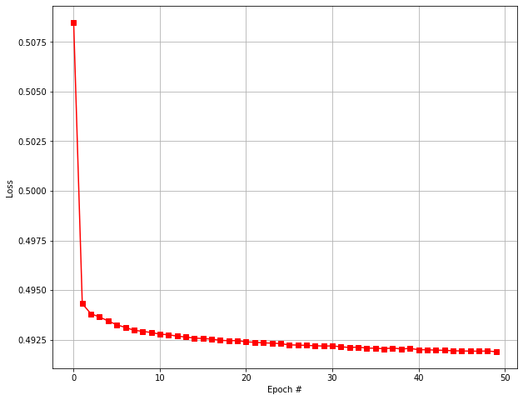
Model Construction
Teammate Names: Matthew Long, Bin Gui, Lance
Our second model was a logistic regression neural network. Similar to the decision tree, we tested different features. Since this model was a neural network, we also tried out different layers.

Slide 7

Performance
Teammate Names: Matthew Long, Bin Gui, Lance
Training
Decision Tree
Logistic Regression
Feature 1
Feature 2
Feature 3
Feature 1
Feature 2
Feature 3
0.76 0.76 0.78
0.7587 0.7587 0.7772
Validation
N/A
0.7566 0.7566 0.7770
Test
0.76 0.76 0.79
0.7636 0.7627 0.7902
Feature 1: Hours per week
Feature 2: Age
Feature 3: Education-num

Slide 8
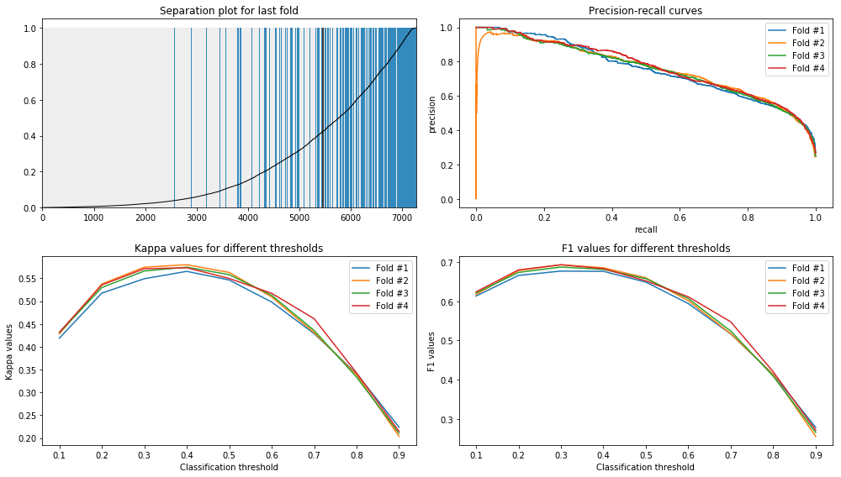
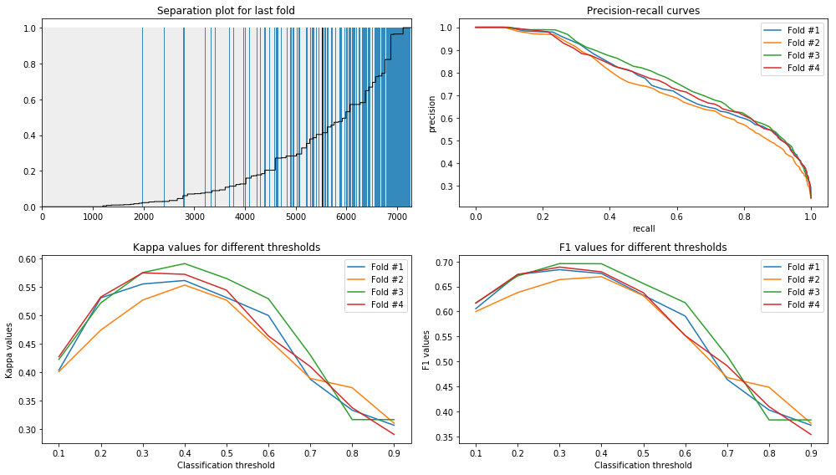
Additional Performances
Logistic Regression: 0.841
Decision Tree: 0.843
https://github.com/itdxer/adult-dataset-analysis/blob/master/Classification.ipynb

Slide 9
Conclusions
Teammate Names: Matthew Long, Bin Gui, Lance
Both our models tied with a 79% accuracy rate for the test set.
Feature 3 proved to be the most accurate in determining the target.
Feature 1 and 2 performed nearly identically across both models.
The outside source further demonstrated that both models produced similar results in terms of accuracy.
From this project, we have learned that data, especially large sets, often form patterns when analyzed through machine learning models. The similarity between performances demonstrates how creating models can be unpredictable and sometimes no singular model is the “correct” choice.

